Slide 1


Machine Learning-Based Driver Assistant System
to Reduce Road Accidents
ROADBUDDY
CDAP_24_25J_197

Slide 2
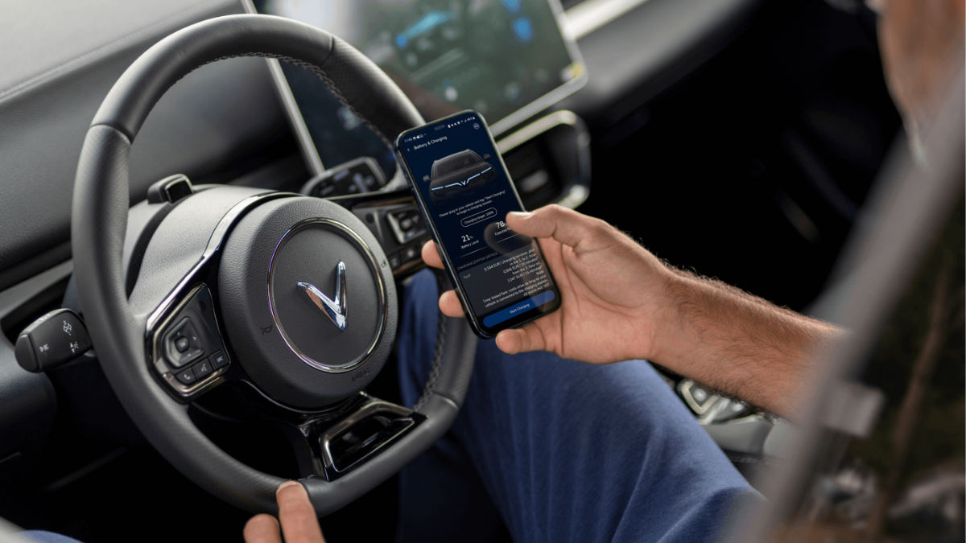
Introduction
RoadBuddy is an app designed to enhance road safety in Sri Lanka by reducing accidents and improving the driving experience. It leverages machine learning algorithms to provide smart solutions for safer driving.

Slide 3

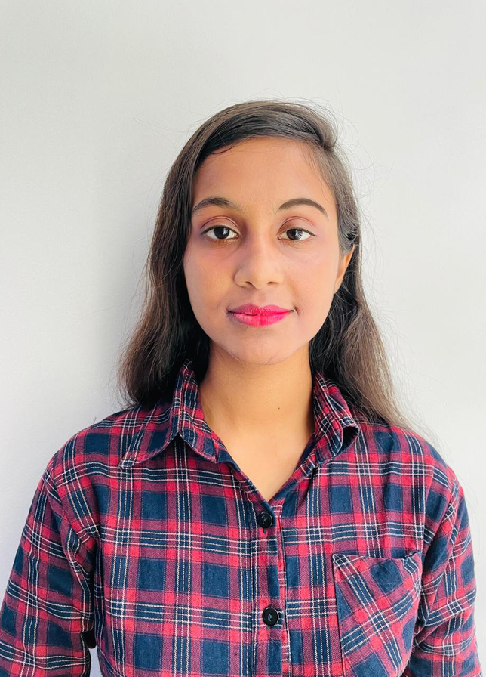




Our Team
Teamwork Is The Key
Bimsara Somarathne
Archana Wijerathne
Chathuni Nayanathara
Kaveeshwara Neelawala
Group Leader
Team member
Team member
Team member
Ravi Supunya
Dulani Maheshika
Supervisor
Co-supervisor

Slide 4
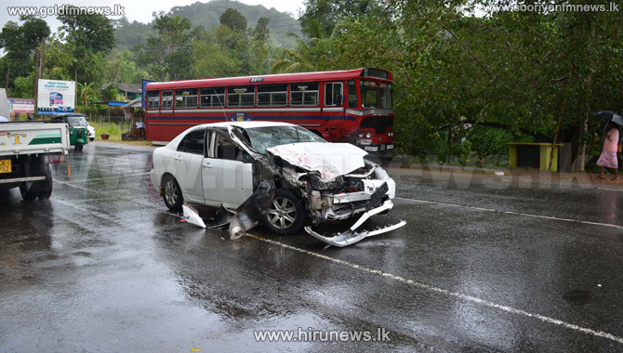

Research Problem
High Rate of Road Accidents
Risky and undisciplined driver behavior
Lack of proper road signs and unclear lane markings in Sri Lanka
Current systems are insufficient to address the root causes of accidents

Slide 5


Objectives
Sub objective 1
To identify drivers’ behavior is violating or not while driving
Main objective is to create a solution for enhancing driver’s safety while using a vehicle
Sub objective 2
To identify every road sign on the road and explain it by narration to the driver
Sub objective 3
To detect suitable parking spots for the vehicle amd
Sub objective 4
Offer immediate alerts and feedback to ensure safe driving practices.

Slide 6
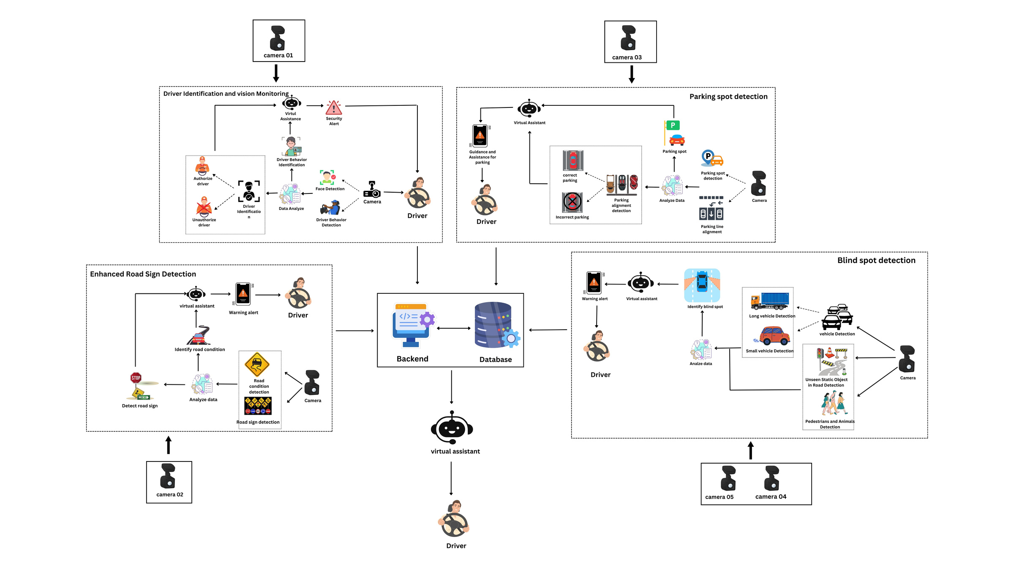
System Architecture

Slide 7


Component 1
Driver behavior monitoring
Somarathne R.M.B.C.
IT21210938

Slide 8


Research Gap
Comparison with existing projects
 | Project 1 | Project 2 | Project 3 | Proposed System
Biometric Authentication
Driver Vision monitoring
Driver Behavior detection
Warn driver by narration
Fatigue identification

Slide 9
Objectives
Main Objective
To identify drivers who use the vehicle and monitor the drivers’ vision and behavior while driving the vehicle
SUB OBJECTIVE 1
SUB OBJECTIVE 2
SUB OBJECTIVE 3
Data collection and pre-processing the data
Implementing the model and the UIs for them
Integration and testing

Slide 10
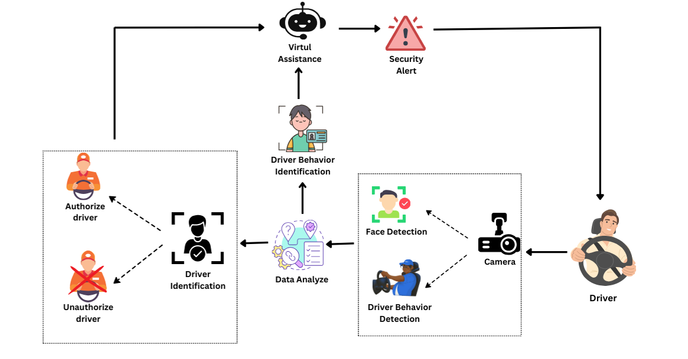
Architecture Diagram

Slide 11





Technologies and Algorithms
Tenserflow
Python
Flutter
MobileNetV2
Inception v3
Google Colab

Slide 12
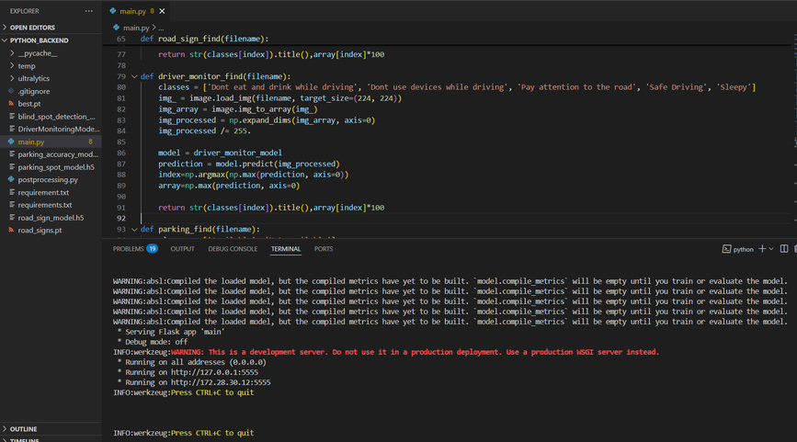
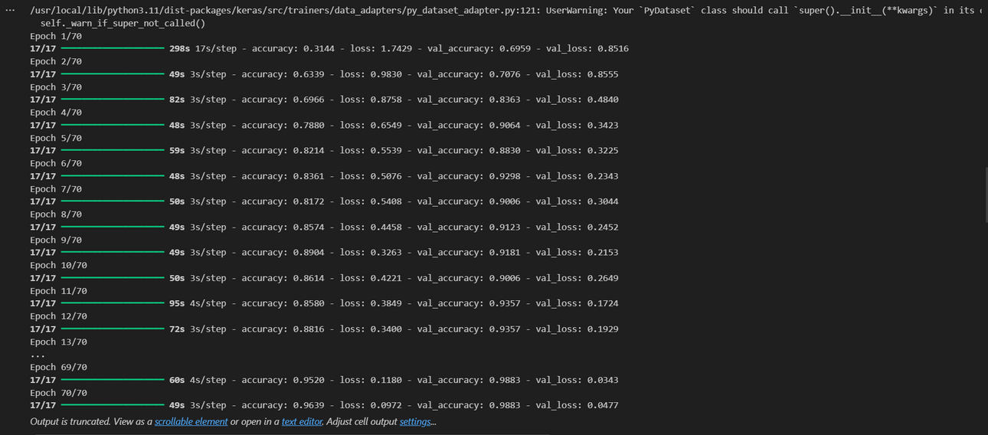

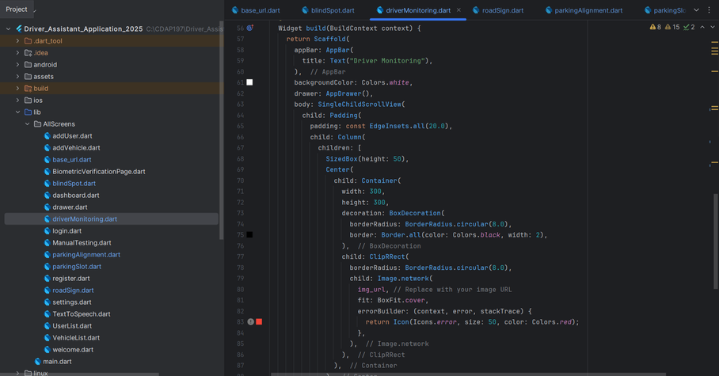
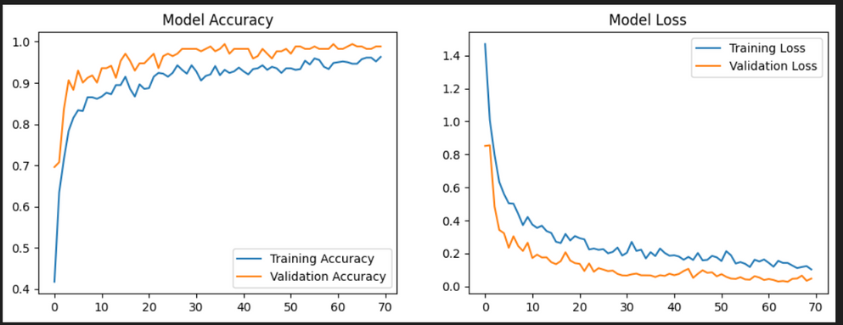
Evidences for Completion
Architecture of Implementation
Model training using google colab ( MobileNetV2)
Frontend and Backend

Slide 13
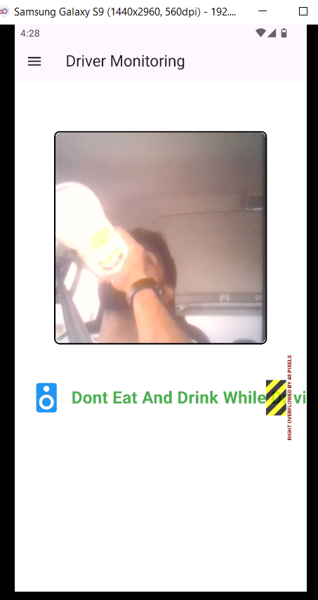
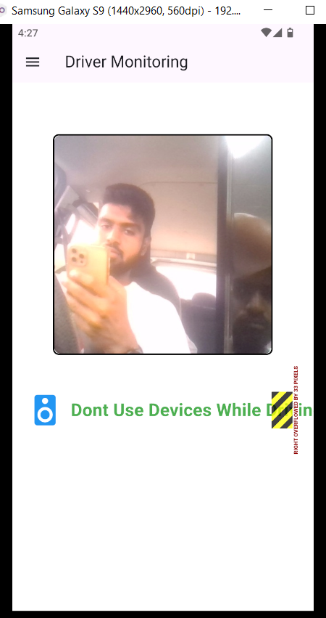
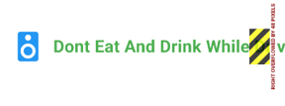
Evidences for Completion
Final outputs that show a mobile interface detecting driver behaviors
Display voice based alerts to warn the driver

Slide 14
References
[1] World Bank, "Delivering Road Safety in Sri Lanka: Leadership Priorities and Initiatives to 2030," [Online]. Available: https://documents.worldbank.org/curated/en/976361582088610795/pdf/Delivering-Road-Safety-in-Sri-Lanka-Leadership-Priorities-and-Initiatives-to-2030.pdf.
[2] "Prioritizing Road Safety: A Global Challenge and Sri Lanka's Perspective," Numbers.lk, [Online]. Available: https://numbers.lk/news/prioritizing-road-safety-a-global-challenge-and-sri-lanka-s-perspective.
[3] N. D. Sinclair, "Three Ways to Improve Road Safety in Sri Lanka," Asian Development Blog, 15-Jan-2024, [Online]. Available: https://blogs.adb.org/blog/three-ways-improve-road-safety-sri-lanka.

Slide 15
Component 2
Advanced road sign detection and narration
Wijerathne G.A.R.
IT21349638

Slide 16
Research Gap
Comparison with existing projects
 | Project 1 | Project 2 | Project 3 | Proposed System
Road signs identification
Real time monitoring
Warn driver by narration
Night time visibility
Identifying with various environmental conditions

Slide 17
Objectives
Main Objective
To identify every road sign on the road and explain it by narration to the driver
SUB OBJECTIVE 1
SUB OBJECTIVE 2
SUB OBJECTIVE 3
Data collection
pre-processing
Implementing the model
Designing UIs
UI implementation
Integration and testing

Slide 18
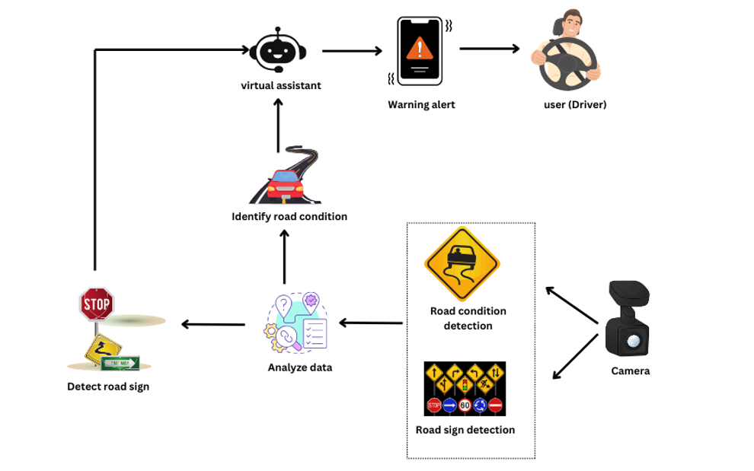
Architecture Diagram
Advanced road sign detection and narration

Slide 19
Technologies and Algorithms
Tenserflow
Python
Flutter
MobileNetV2
Google Colab

Slide 20
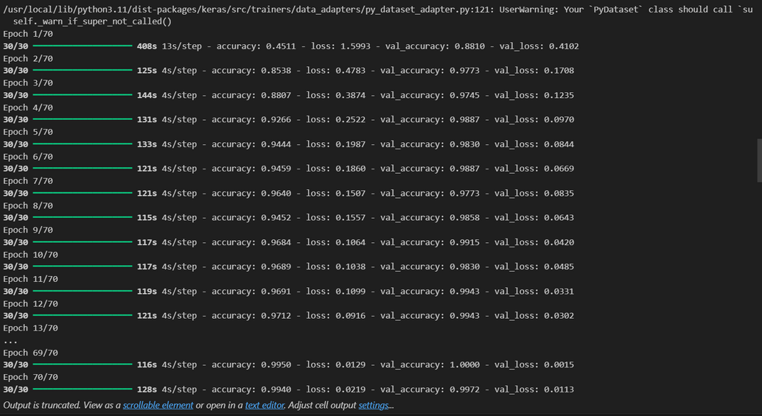
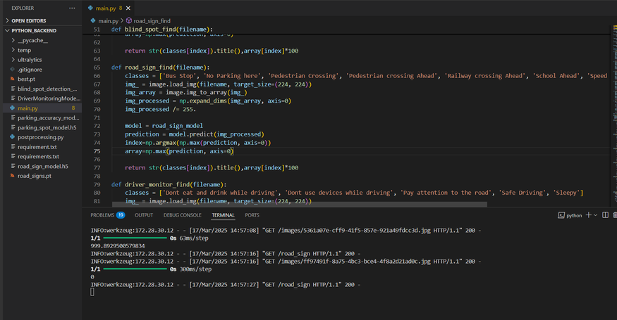
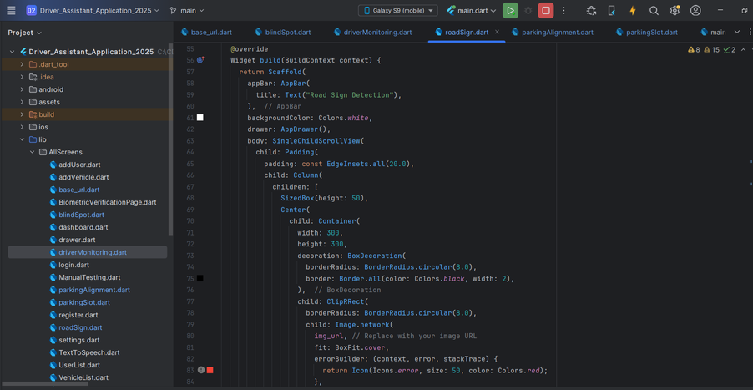
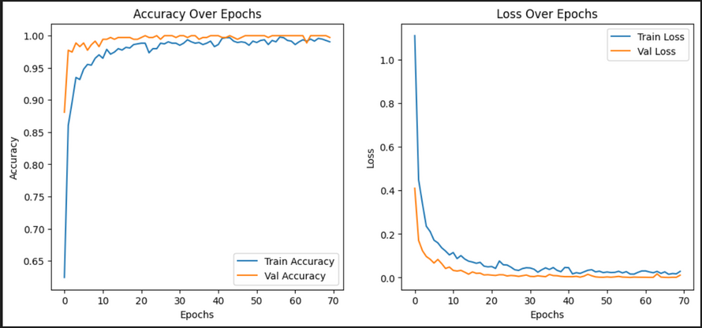
Evidences for Completion
Architecture of Implementation
Model training using google colab ( MobileNetV2)
Frontend and Backend

Slide 21
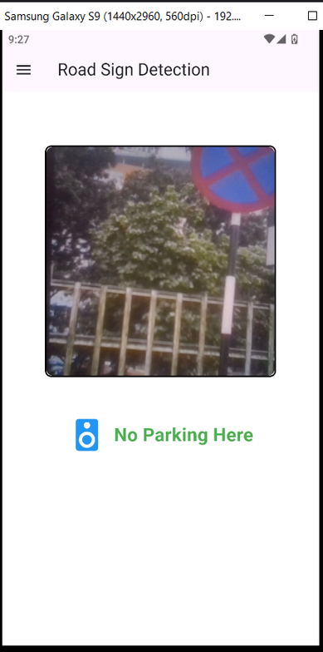
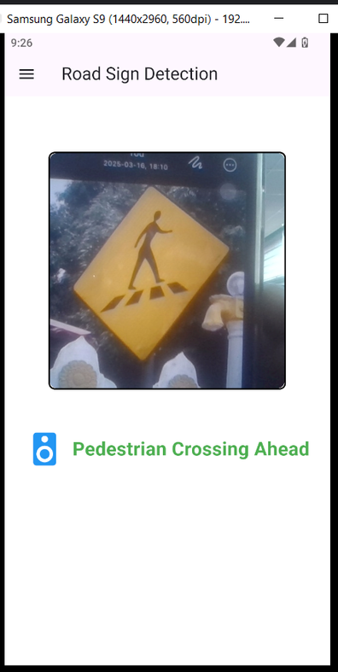

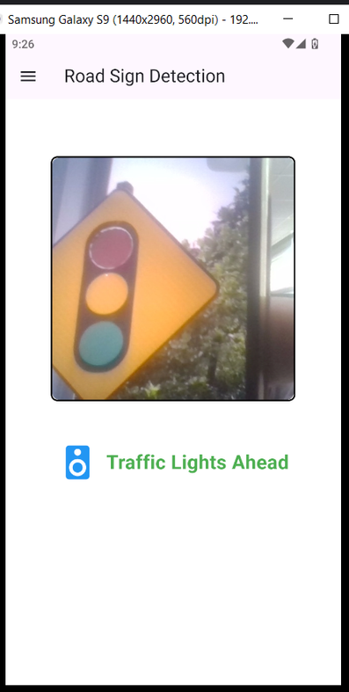
Evidences for Completion
Final outputs that show a mobile interface detecting road signs
Display voice based alerts to warn the driver

Slide 22
References
[1] S. Wijerathne, K. Perera, and A. Dias, "Road sign recognition using image processing," *J. Eng. Res.*, vol. 12, no. 2, pp. 115-126, 2018.
[2] L. Perera, M. Silva, and S. Jayawardena, "Climate condition detection for vehicle safety," *Int. J. Automot. Technol.*, vol. 14, no. 3, pp. 234-245, 2019.
[3] P. Fernando, A. Dias, and R. Senanayake, "Real-time feedback systems for enhanced driving," *IEEE Trans. Intell. Veh.*, vol. 19, no. 1, pp. 34-45, 2020.
[4] H. Gunawardena, K. Rathnayake, and N. Kumarasinghe, "Integrating road sign and climate detection in driver assistance systems," *J. Veh. Technol.*, vol. 11, no. 3, pp. 89-101, 2021.

Slide 23
Component 3
Blind spot identification with object detection
Nayanathara R.M.C.
IT21365300

Slide 24
Research Gap
Comparison with existing projects
 | Project 1 | Project 2 | Project 3 | Proposed System
Blind spot identification
Distance measurement
Warn driver by narration
Night time visibility
Real time outputs

Slide 25
Objectives
Main Objective
To detect whatever that can be affected to the vehicle by hitting on it and alerting the driver about the situation before it happened
SUB OBJECTIVE 1
SUB OBJECTIVE 2
SUB OBJECTIVE 3
Data collection
Image classification
pre-processing
Model implementation
Designing UIs
UI implementation
Integration and testing

Slide 26
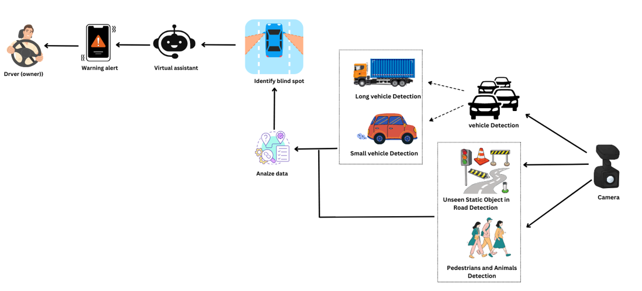
Architecture Diagram
Blind spot identification with object detection

Slide 27
Technologies and Algorithms
Tenserflow
Python
Flutter
MobileNetV2
Google Colab

Slide 28
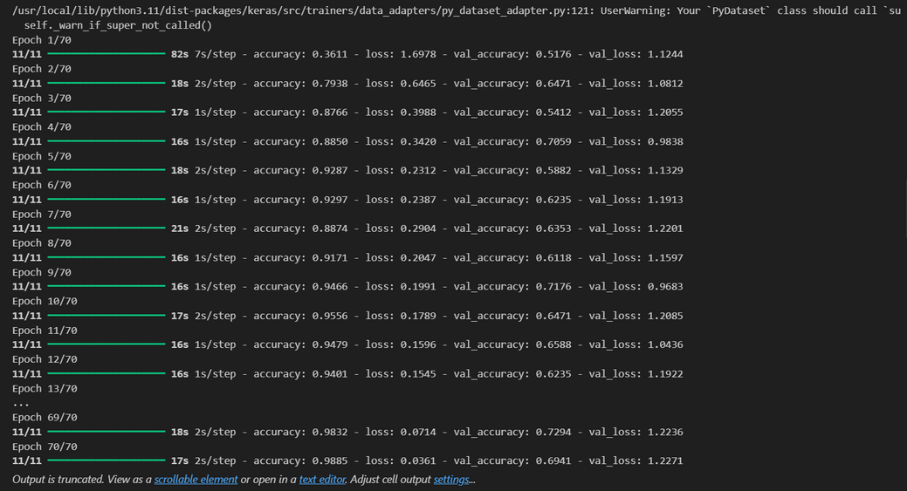
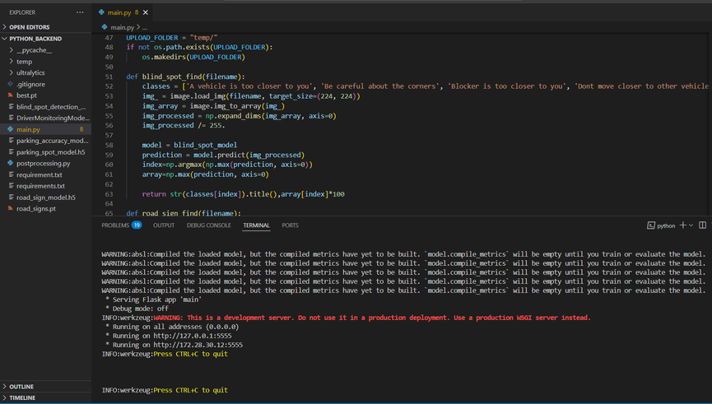
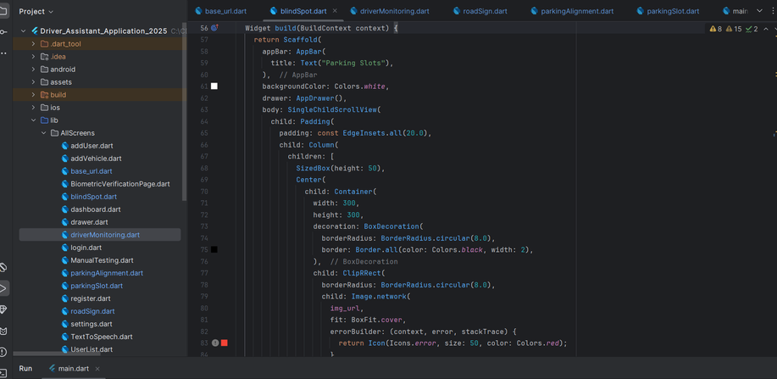
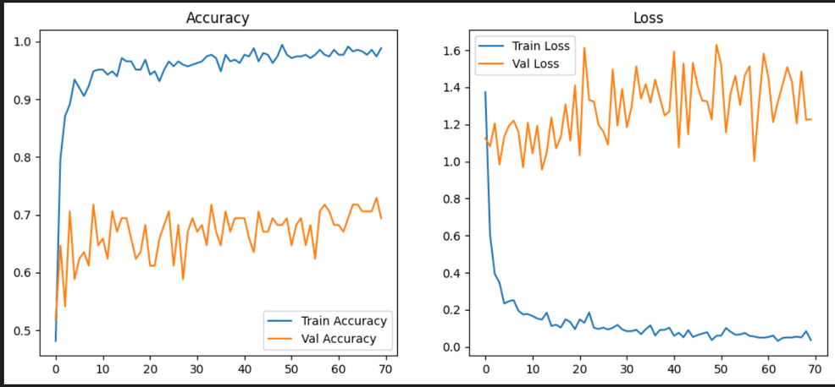
Evidences for Completion
Architecture of Implementation
Model training using google colab ( MobileNetV2)
Frontend and Backend

Slide 29
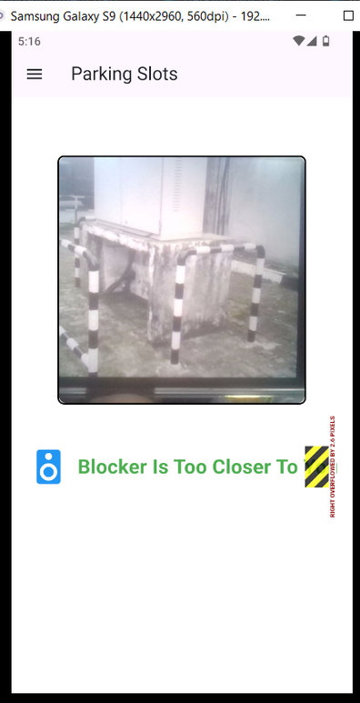
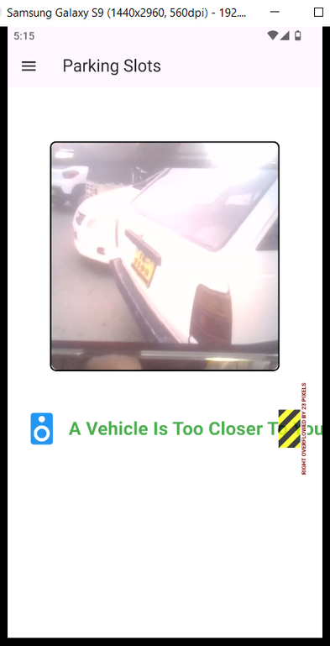

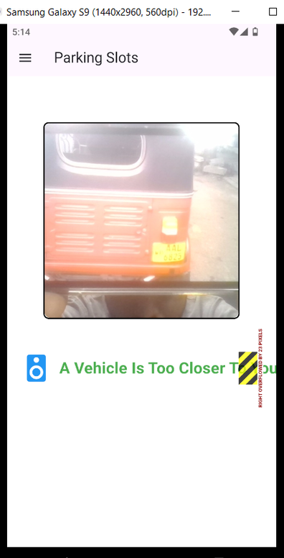
Evidences for Completion
Final outputs that show a mobile interface detecting blind spot
Display voice based alerts to warn the driver

Slide 30
References
[1] "Object Detection for Road Safety," University of Moratuwa, 2021. This study focused on developing a basic object detection system using image processing techniques but did not integrate real-time monitoring or distance measurement.
[2] "Traffic Alert Systems in Sri Lanka," University of Peradeniya, 2022. This research highlighted the development of traffic alert systems to inform drivers of upcoming traffic jams but did not link this with blind spot detection capabilities.
[3] "Enhancing Road Safety with ADAS," University of Colombo, 2023. This paper discussed various ADAS features but lacked a comprehensive approach to integrating blind spot detection with distance measurement.

Slide 31
Component 4
Parking Spot detection with parking alignment
Neelawala P.K.N.G.K.B.
IT21231728

Slide 32
Research Gap
Comparison with existing projects
 | Project 1 | Project 2 | Project 3 | Proposed System
Detecting parkings
Parking alignment
Night time visibility
Real time results
Assistance by narration

Slide 33
Objectives
Main Objective
Identification of the parking spaces that exactly fits to the vehicle and assist the driver when parking
SUB OBJECTIVE 1
SUB OBJECTIVE 2
SUB OBJECTIVE 3
Data collection
Image classification
pre-processing
Model implementation
Designing UIs
UI implementation
Integration and testing

Slide 34
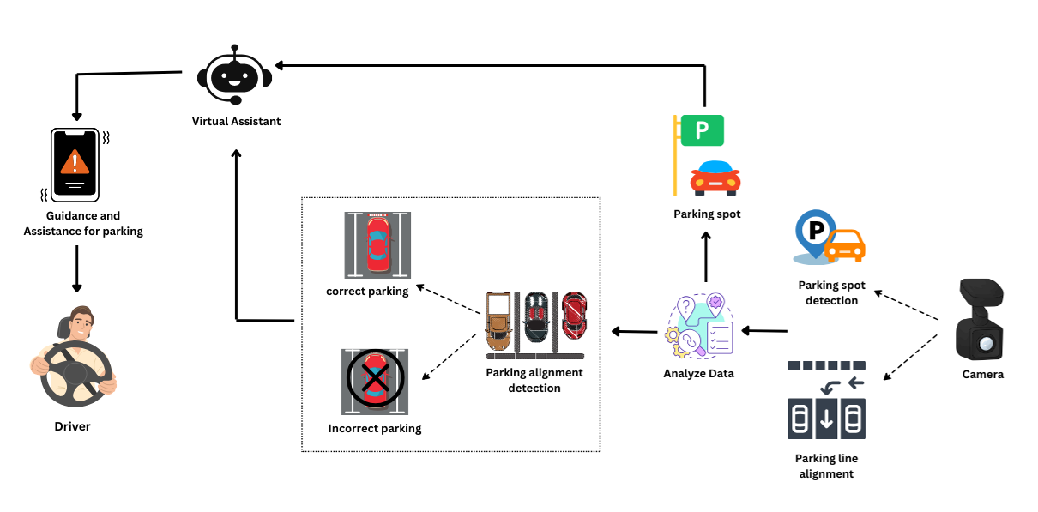
Architecture Diagram
Parking Spot detection with parking alignment

Slide 35
Technologies and Algorithms
Tenserflow
Python
Flutter
MobileNetV2
Google Colab

Slide 36
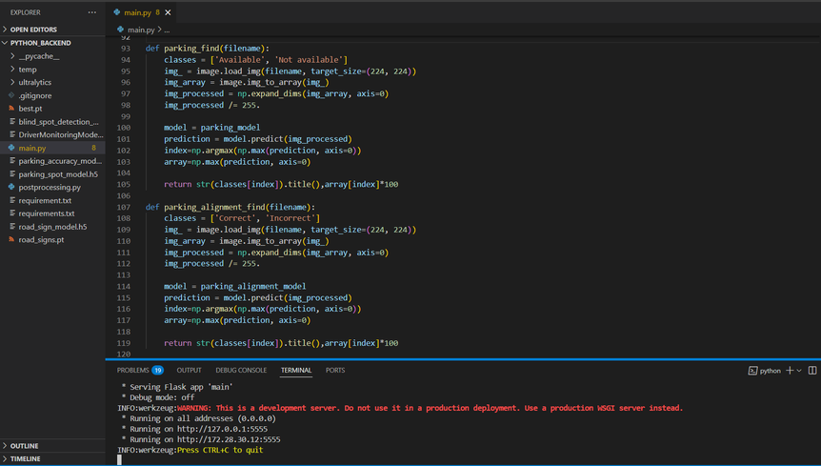
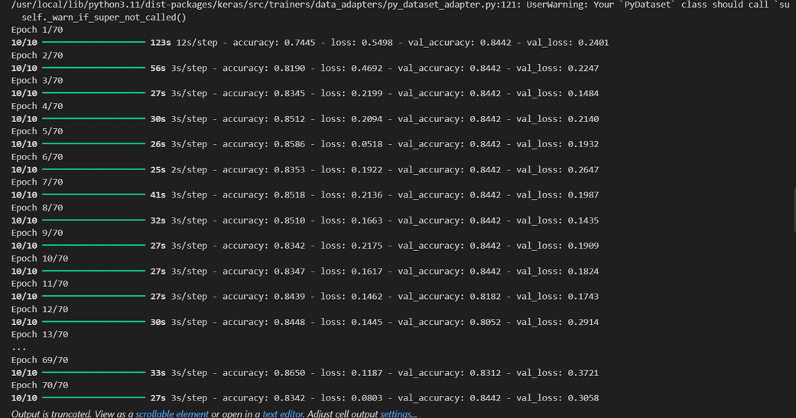
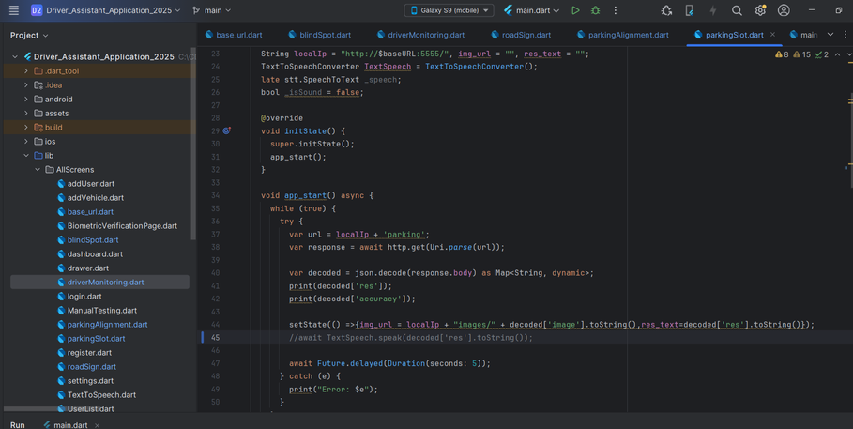
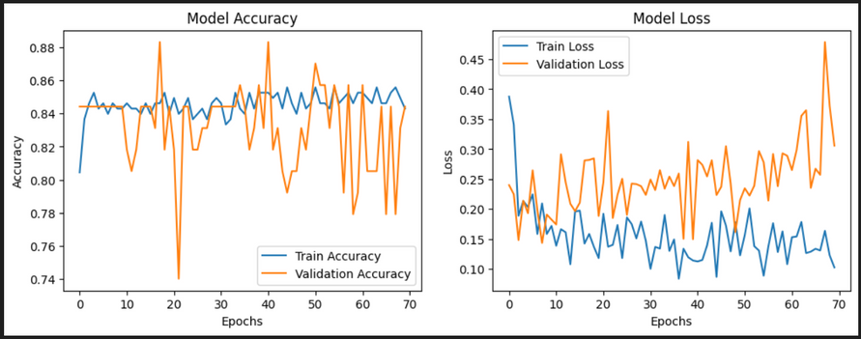
Evidences for Completion
Architecture of Implementation
Model training using google colab ( MobileNetV2)
Frontend and Backend

Slide 37
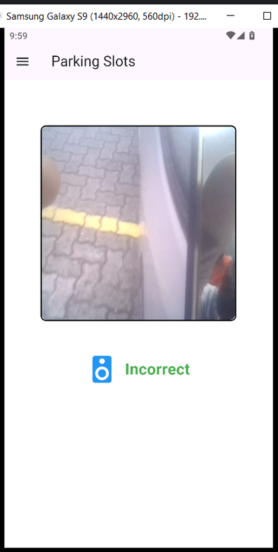
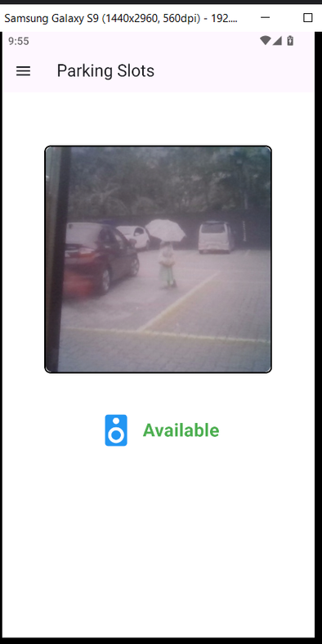
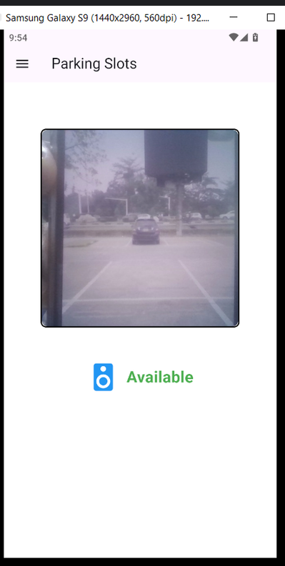

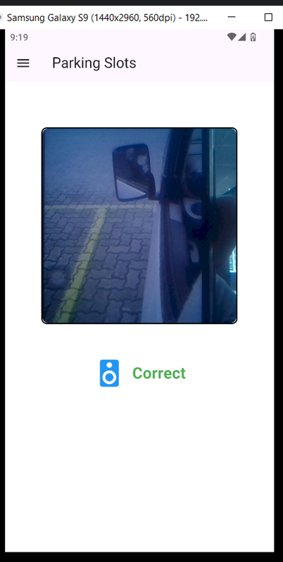
Evidences for Completion
Display voice based alerts to warn the driver
Final outputs that show a mobile interface detecting parking spot and parking alignement

Slide 38
References
[1] World Bank, "Delivering Road Safety in Sri Lanka: Leadership Priorities and Initiatives to 2030," [Online]. Available: https://documents.worldbank.org/curated/en/976361582088610795/pdf/Delivering-Road-Safety-in-Sri-Lanka-Leadership-Priorities-and-Initiatives-to-2030.pdf.
[2] "Prioritizing Road Safety: A Global Challenge and Sri Lanka's Perspective," Numbers.lk, [Online]. Available: https://numbers.lk/news/prioritizing-road-safety-a-global-challenge-and-sri-lanka-s-perspective.
[3] N. D. Sinclair, "Three Ways to Improve Road Safety in Sri Lanka," Asian Development Blog, 15-Jan-2024, [Online]. Available: https://blogs.adb.org/blog/three-ways-improve-road-safety-sri-lanka.

Slide 39
Commercialization
Target Market
Private vehicle owners, fleet managers, logistics companies.
Start with Sri Lanka, expand to other developing nations.
Revenue Streams
Monthly/yearly subscription for premium users.
Collaborate with car manufacturers and insurance companies.
Distribution Channels
Google Play and Apple App Store.
Distribute via car rental services and driving schools.
Marketing Strategy
Promote through social media and search engines.
Collaborate with auto industry influencers.

Slide 40

18/03/2025
THANK YOU

